Slide 1



Hierarchical Control Structure in Automotive Software Architecture
Meenal Shah

Slide 2


Agenda
INDUSTRY NEED
GENERAL SOFTWARE ARCHITECTURE FOR AUTOMOTIVE SYSTEM
BENEFITS
HEIRARCHICAL CONTROL STRUCTURE
TRADE OFFS

Slide 3
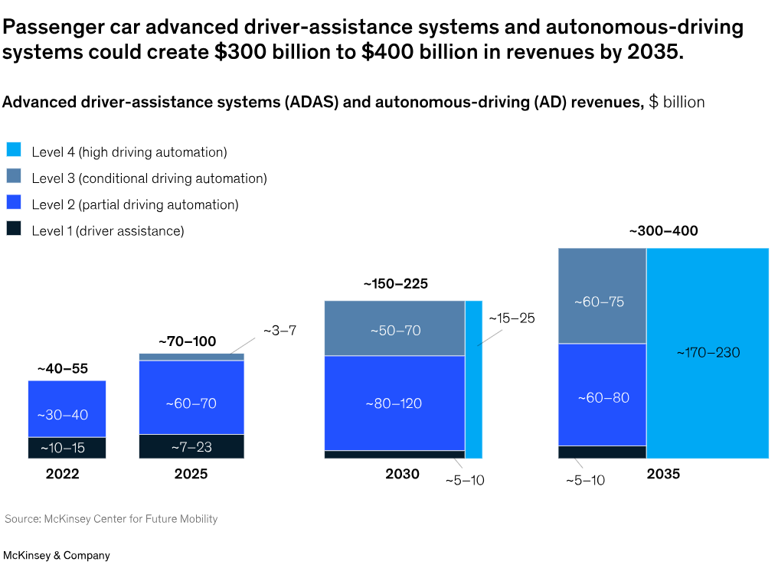
Industry Need
Reference Link: “The future of autonomous vehicles (AV) | McKinsey.” Accessed: Jan. 22, 2025. [Online]. Available: https://www.mckinsey.com/industries/automotive-and-assembly/our-insights/autonomous-drivings-future-convenient-and-connected
Notes:
By 2035, autonomous driving (AD) is projected to generate $300–$400 billion, transforming the passenger car market. AD enhances safety, convenience, and mobility, especially for elderly drivers, while giving consumers more time for work or leisure. Automakers must embrace new strategies and tackle safety concerns to meet rising demand. To support software design, the industry must integrate modern software practices, aligning with the needs of developers, manufacturers, suppliers, and strict safety regulations.

Slide 4
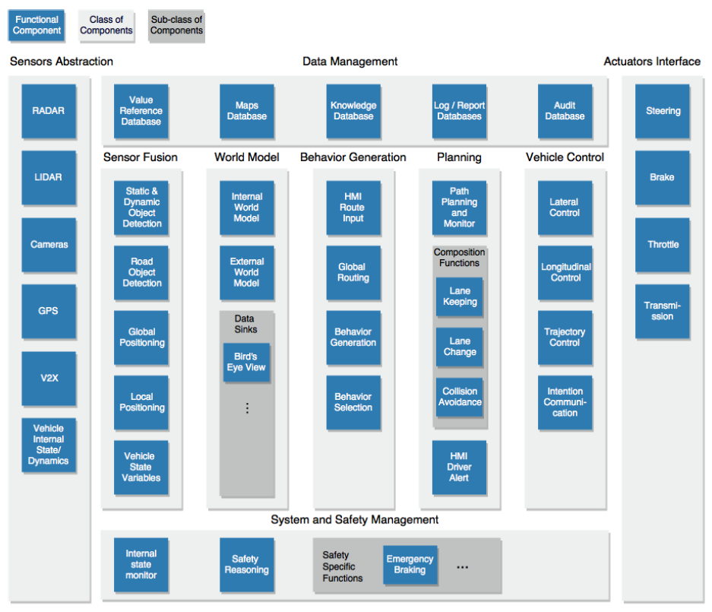
GENERAL SOFTWARE ARCHITECTURE FOR AUTOMOTIVE SYSTEM
Component Classification: Vehicle control, actuator interfaces, planning, behaviour generation, data management, and system safety.
Sensor data moves to actuator interfaces, from left to right, forming a closed control loop.
Reference Link: A. Serban, E. Poll, and J. Visser, “A Standard Driven Software Architecture for Fully Autonomous Vehicles.” Accessed: Feb. 05, 2025. [Online]. Available: https://jstvssr.github.io/assets/pdf/standard-driven-software-architecture.pdf
Notes:
This architecture, proposed by Serban et al., follows a closed-loop system from sensors to actuators, aligning with SAE J3016 standards. Sensor fusion processes raw data, extracting insights and making quick decisions like speed adjustments. The world model constructs the vehicle’s perception of its surroundings, which the behavior generation module uses to evaluate possible actions. The planning module then makes long-term driving decisions, passing them to the vehicle control system. Finally, these decisions are executed by the actuators, ensuring safe and efficient vehicle operation.

Slide 5
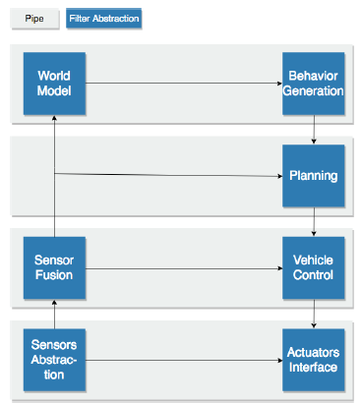
Hierarchical Control Structure
Increasing Abstraction and Cognition
Mapping to SAE Classification
Balanced representation of reactive and deliberative components
No temporal limitations for a component’s knowledge
More flexible in case of interactions than layered architecture
Similar to component based architecture, best suited for ECUs, with hierarchical reasoning
Reference Link: A. Serban, E. Poll, and J. Visser, “A Standard Driven Software Architecture for Fully Autonomous Vehicles.” Accessed: Feb. 05, 2025. [Online]. Available: https://jstvssr.github.io/assets/pdf/standard-driven-software-architecture.pdf
Notes:
The hierarchical control structure is a key aspect of this architecture, enabling component abstraction while aligning with the SAE classification of functional components. Lower-level components manage fundamental tasks, such as speed control, while higher-level components utilize this data to develop richer semantic knowledge and make more informed decisions, such as determining the optimal path to a destination.
For component interactions, the architecture employs a pipe-and-filter pattern for flat control structures, ensuring efficient data flow, while a tee-and-join pattern represents hierarchical relationships, facilitating structured decision-making. This design enhances flexibility, adaptability, and scalability, allowing for the seamless integration of new sensors and processes.
Moreover, the hierarchical structure ensures a balanced representation of both reactive and deliberative components, optimizing overall system performance. Unlike a layered architecture, which imposes strict top-down function calls and limits component interactions, the hierarchical control structure provides greater flexibility. Additionally, it offers an advantage over a component-based architecture, which is best suited for ECUs, by incorporating hierarchical reasoning, making it a more effective solution for complex automotive systems.

Slide 6
Benefits and Drawbacks
Benefits:
Clear discrimination b/w reactive and deductive components
Facilitates component reuse
Compliance with SAE J3016
Supports incremental Development of fully autonomous vehicles
Drawbacks:
Too complex at times
Potential oversimplification of components, especially with emergence of system-on-a-chip technologies
Notes:
Benefits of the NIST RCS architecture include clear distinction between reactive and deductive components, hierarchical representation of processes, component reuse across vehicles, alignment with SAE J3016 standards, and support for incremental development from partially automated to fully autonomous vehicles. However, it also has drawbacks, such as complexity, especially for simple nodes, and the risk of oversimplification due to atomic decomposition, particularly with advanced system-on-a-chip circuits.

Slide 7
References
A. Serban, E. Poll, and J. Visser, “A Standard Driven Software Architecture for Fully Autonomous Vehicles.” Accessed: Feb. 05, 2025. [Online]. Available: https://jstvssr.github.io/assets/pdf/standard-driven-software-architecture.pdf
“The future of autonomous vehicles (AV) | McKinsey.” Accessed: Jan. 22, 2025. [Online]. Available: https://www.mckinsey.com/industries/automotive-and-assembly/our-insights/autonomous-drivings-future-convenient-and-connected

Slide 8

Thank you
Feel free to ask questions ☺

